Slide 2
Assoc. Prof. Anucha Sirimalaisuwan
Department of Veterinary Biosciences
and Veterinary Public Health
Faculty of Veterinary Medicine, Chiang Mai University

Slide 3
What research do you conduct?
Types of research
What research questions do you want to address?
Survey of specific zoonotic disease
Epidemiology of important zoonotic disease
Effects of environment changes on infection biology.

Slide 4
How do you conduct research?00
Human resources: what expertise, staff
3 Departments
Research groups
Center for elephant and wildlife health
Research center of VPH
Collaboration with DLD
Environment-facilities: infrastructure, equipment?
Central Lab : BSL enhanced
Bacteriology : VITEK2®
Virology : viral isolation
Molecular biology : Real time PCR

Slide 5
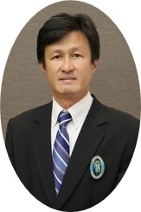
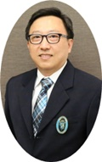
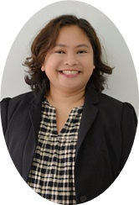
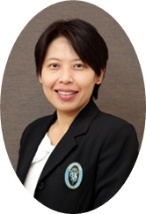
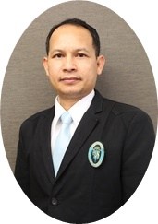
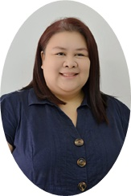
Asst. Prof. Dr. Sahtchai Tangtrongsup
Vector borne disease
Assoc. Prof. Dr. Anucha Sirimalaisuwan
Zoonoses, emerging zoonoses
Dr. Thattawan Kaewsakorn
Pathologist, Laboratory animal expert
Assoc. Prof. Dr. Saruda Tiwanuntakorn
Vector borne disease
Assoc. Prof. Dr. Krisadakorn Prinkprao
Virologist, Pathologist
Dr. Sasisophin Chailangkarn
Parasitologist

Slide 6
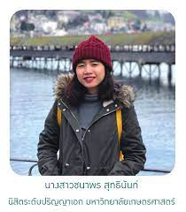
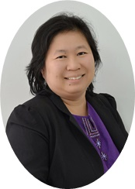
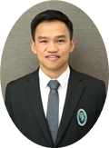
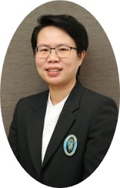
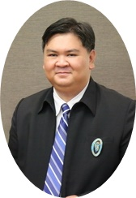
Dr. Chanaporn Suttinant
Entomologist
Assoc. Prof. Dr. Veerasak Punyapornwittaya
Epidemiologist
Dr. Thawatchai Singhla
TB in cattle
Asst. Prof. Dr. Kannika Na Lampang
Epidemiologist
Asst. Prof. Dr. Warangkana Chaisawwong
Epidemiologist
Assoc. Prof. Dr. Natawotti Sathitmathee
Vector borne disease, Vaccinologist

Slide 7
How would you like to contribute to a research proposal ?
Expertise in bacterial and viral zoonoses
Conventional and molecular methods for the detection of agents
Zoonoses control
Develop proposal, collect and analyze samples / data analysis.

Slide 8
How would you like to improve your research/activities?
More collaboration between partners in Mekong subregion

Slide 9
What knowledge gaps would you like to address?
Diseases ecosytem in wildlife

Slide 10
What is the most important/pressing question you would like to address in a ONE-HEALTH research proposal ?
What and how we can get support from PRESTO

